Slide 1
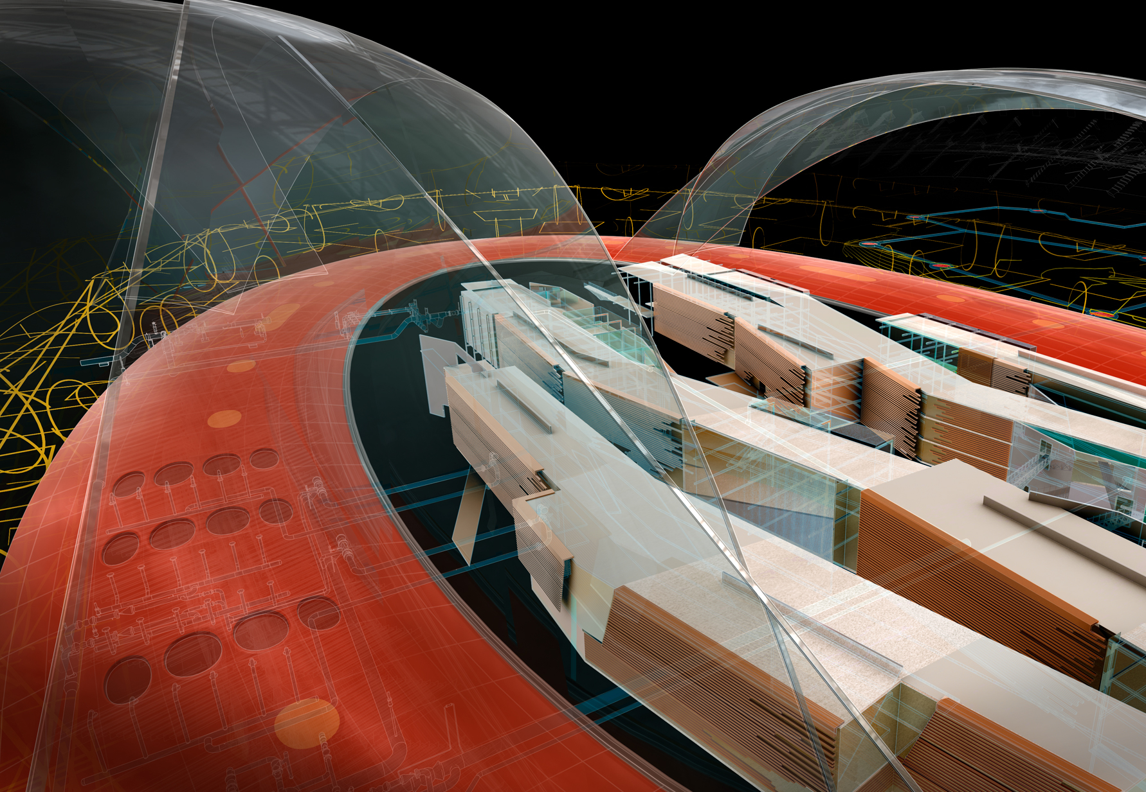
Solving the “Grid To Ground” Problem with Custom Coordinate Systems
Image courtesy of Hobart, Yañez, Ramos, Maguey, and Martínez
Richard Sincovec, LSI
President, Quux Software
Manager of Technology, Edward-James Surveying

Slide 2
About the Presenter – Richard Sincovec, LSI
Manager of Technology Edward-James Surveying, Inc. http://www.ejsurveying.com
Founder and President Quux Software, LLC http://www.quuxsoft.com
More than 10 years of experience as a Land Surveyor
More than 15 years of experience as a Software Engineer
Creator of the Sincpac-C3D add-on software for Civil 3D
Known as “Sinc” in many online forums and communities
Contributor at Civil3D.com

Slide 3
The Heart of the Problem…
We live and work on a spherical Earth.
For Civil Engineering and Surveying, we prefer to use Plane Geometry, rather than Geodetic Geometry, to simplify the mathematics.
Even though we don’t want to use geodetic mathematics, we still want a georeferenced coordinate system.

Slide 4
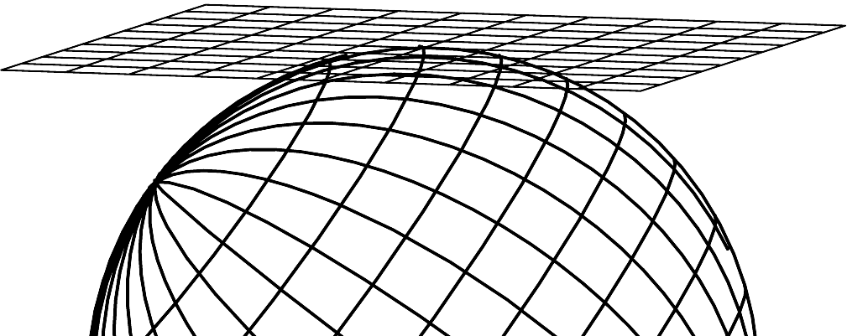
“Project” Coordinate System
Also called a “Ground” System.
Simple grid on a flat plane.
Only accurate at the point where the grid plane touches the ground surface.
Accuracy rapidly decreases with distance from base point.
Single point of accuracy.

Slide 5
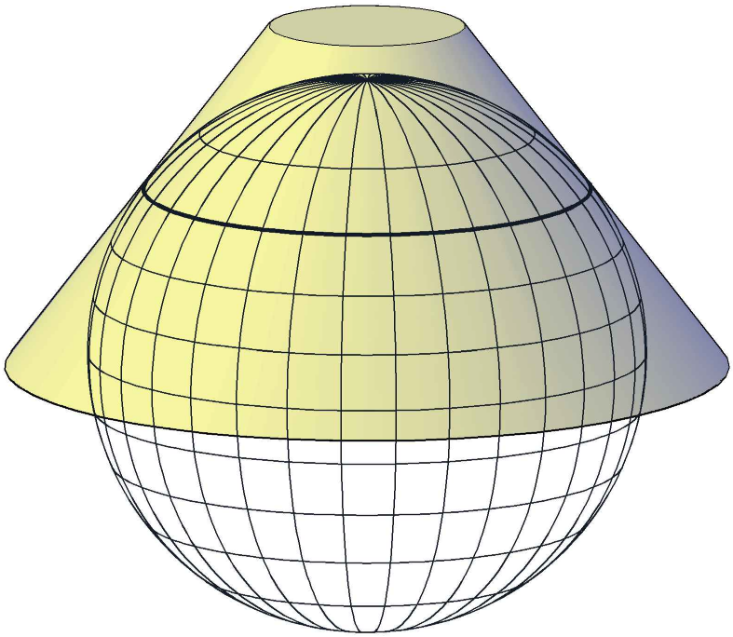
Map Projections
Rather than attempting to use a flat surface for our coordinate grid, we place the coordinate grid on a curved surface, reducing the amount of distortion.
Coordinate grid is on the curved surface (typically a cone or cylinder)
There is now an entire line of minimal distortion, instead of only a single point.

Slide 6
Projection Distortion
When mapping a curved surface to a plane, we distort angles, distances, or areas. This is unavoidable.
By selecting an appropriate projection type, we can preserve one of the three properties.
Equal-Area Projection: Preserves areas
Equidistant Projection: Preserves distances
Conformal Projection: Preserves shapes
For a coordinate system, we should use a conformal projection, so that we preserve the angles between lines.

Slide 7
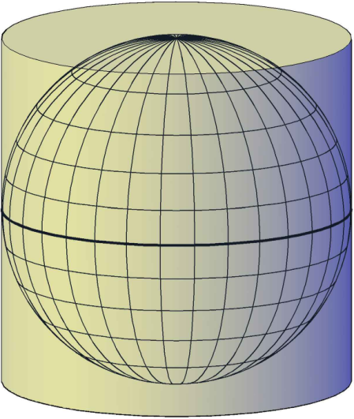
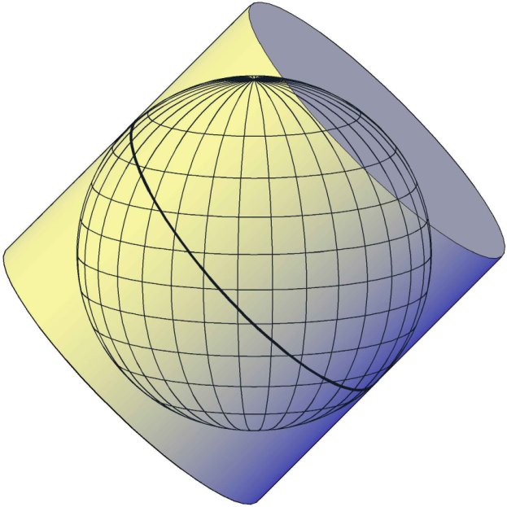
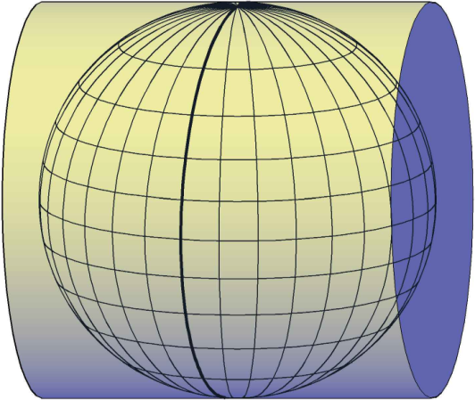
Common Projection Types
Lambert Conic
Mercator
Transverse Mercator
Oblique Mercator

Slide 8
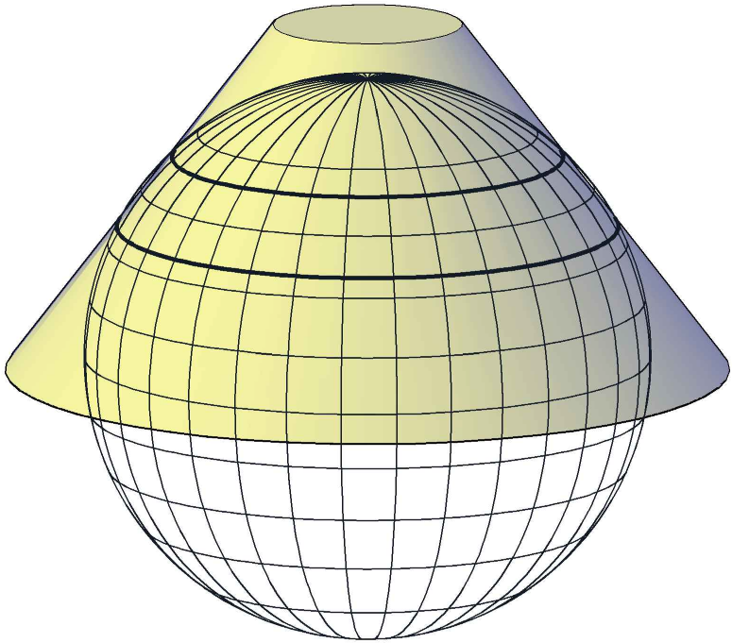
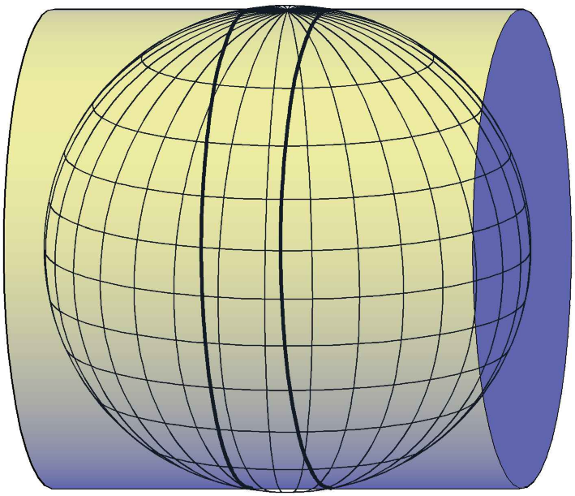
Secant Projections
The projection surface is sunk into the surface of the Earth, so that there are now two lines of minimal distortion. This allows us to use our coordinate system over an even greater area.
Two lines of minimal distortion.
Two lines of minimal distortion.
Ellipsoid

Slide 9
Basic Concepts
Let’s begin by defining some basic working concepts, including:
The Ellipsoid
The Datum
The Geoid

Slide 10
The Ellipsoid
Simply a mathematical construct, approximating the roughly-ovoid shape of the Earth.
Ellipsoid parameters may be specified in a variety of ways, but most-commonly by the Major Axis and Flattening Coefficient.
Minor Axis
Major Axis
Ellipsoid

Slide 11
Common Ellipsoids
Ellipsoid Name | Equatorial Axis | Polar Axis | Inverse Flattening
Clarke 1866 | 6,398,206.4 m | 6,376,516.0 m | 294.9786982
GRS 1980 | 6,378,137.0000 m | 6,356,752.3141 m | 298.257222101
WGS 1984 | 6,378,137.0000 m | 6,356,752.3142 m | 298.257223563
The Clarke 1866 Ellipsoid is the basis for NAD 27
The GRS 1980 Ellipsoid is the basis for NAD 83

Slide 12
Geodetic Datums
When an Ellipsoid is attached to the Earth at a specific reference point and with a specific orientation, it is a Datum.
Points on the Earth may now be located in relation to the Datum, using a Latitude, Longitude, and Ellipsoidal Height.
Ellipsoidal Height is the distance between the Ellipsoid surface and the Ground elevation, and is not the same thing as the Elevation.

Slide 13
The Geoid
The Geoid is the surface of equipotential gravity, e.g. where Elevation = 0 (zero)
Typically differs from the Ellipsoid by as much as ±100 meters because of localized gravity fluctuations
Ground Surface
Geoid
Ellipsoid
Projection Surface

Slide 14
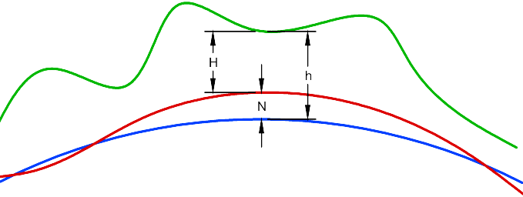
The Geoid (continued)
GPS equipment returns Ellipsoidal Height
The Geoid is used to convert Ellipsoidal Height to the orthometric Elevation
In horizontal coordinate transformations, the Geoid is only used to convert between Elevation and Ellipsoidal Height, which may be necessary to calculate an Elevation Factor
H = Orthometric Elevation
N = Geoid Height
h = Ellipsoidal Height
Ground Surface
Geoid
Ellipsoid

Slide 15
Common Datums
North American Datum of 1927 (NAD27)
Clarke 1866 Ellipsoid
Attached at Meads Ranch, Kansas
Is not geocentric
North American Datum of 1983 (NAD83)
GRS 1980 Ellipsoid
Intended to be geocentric, but in reality is not quite geocentric
Later realizations such as NAD83(2007) follow the movement of the North American tectonic plate

Slide 16
Common Datums (continued)
World Geodetic System of 1984 (WGS84)
WGS 1984 Ellipsoid
Defined to be geocentric
Since NAD83 was thought to be geocentric when originally defined, NAD83 and WGS84 were initially virtually identical
New realizations have gradually diverged from NAD83 as the position of the “center of the Earth” has been refined
WGS84(G730), WGS84(G873), etc.
WGS 1984 Ellipsoid
These datums are updates to the original WGS84 datum
Defined to be geocentric, as closely as can be determined with available technology at time of implementation
Each update is named after the week of its implementation, e.g. WGS84(G730) was implemented Jan. 2, 1994, and WGS84(G873) was implemented Jan. 29, 1997
The “G” in the datum name indicates that the datum was refined using gravitational measurements from satellites

Slide 17
Scale Factors
Projections are idealized, and always involve some amount of distortion.
The Conformal Projections favored for Civil work limit distortion in the shape of objects, at the expense of distorting distances (linear distortion).
We can correct for the linear distortion using Scale Factors:
Grid Scale Factor
Elevation Scale Factor

Slide 18
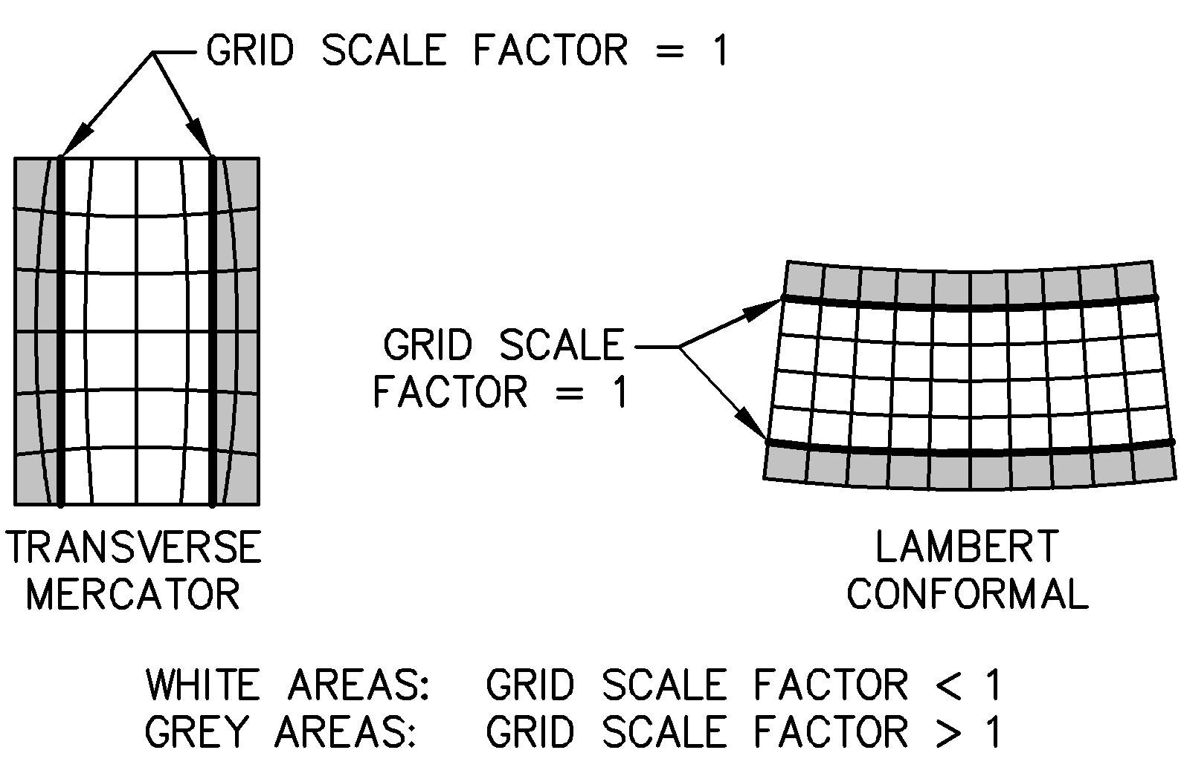
Grid Scale Factor

Slide 19
Grid Scale Factor
k = Grid Scale Factor
A’B’ = k · AB
Grid length A’B’ is less than ellipsoidal length AB
(grid scale factor < 1)
Grid length A’B’ is greater than ellipsoidal length AB
(grid scale factor > 1)
A
B
Ellipsoid
A’
B’
A’
B’
A
Projection Surface
B
Overall Zone Width
Balances positive and negative distortion
1/6
2/3
1/6

Slide 20
Maximum Projection Zone Width | Maximum Linear Horizontal Distortion
 | Parts per Million | Linear Distortion | Ratio
16 miles 26 km | 1 ppm | 0.005 ft/mi 1 mm/km | 1 : 1,000,000
50 miles 80 km | 10 ppm | 0.05 ft/mi 10 mm/km | 1 : 100,000
71 miles 114 km | 20 ppm | 0.1 ft/mi 20 mm/km | 1 : 50,000
112 miles 180 km | 50 ppm | 0.3 ft/mi 50 mm/km | 1 : 20,000
158 miles 254 km | 100 ppm | 0. 5 ft/mi 100 mm/km | 1 : 10,000

Slide 21
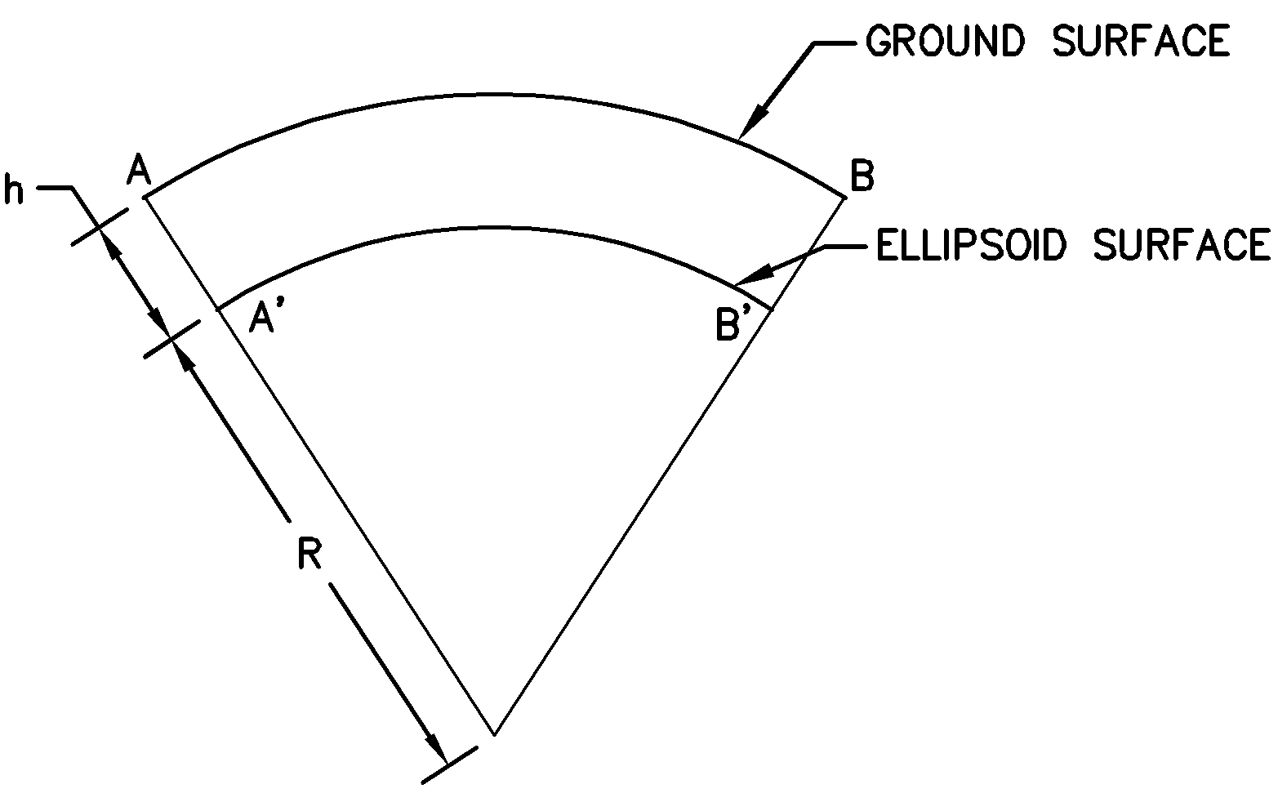
Elevation Scale Factor
For most commonly-used coordinate systems, the Ellipsoid surface is roughly at sea level (Elev = 0.00). This means the ground surface is usually above the Ellipsoid surface.
The Elevation Scale Factor corrects for the difference between distance on the ground and distance on the Ellipsoid.
R is approximate radius of Ellipsoid at our Project location. In the Continental US, it is usually sufficient to use a value of 20,906,000 feet or 6,372,000 meters
R
R + h
r_{e} =
A’B’ = r_{e} · AB
Distance AB is greater than distance A’B’ when ground surface is above Ellipsoid
R = Ellipsoid Radius
h = Ellipsoidal Height
r_{e} = Elevation Scale Factor

Slide 22
Height Above and Below Projection Surface | Maximum Linear Horizontal Distortion
 | Parts per Million | Linear Distortion | Ratio
20 feet 6 meters | 1 ppm | 0.005 ft/mi 1 mm/km | 1 : 1,000,000
210 feet 63 meters | 10 ppm | 0.05 ft/mi 10 mm/km | 1 : 100,000
420 feet 127 meters | 20 ppm | 0.1 ft/mi 20 mm/km | 1 : 50,000
1050 feet 319 meters | 50 ppm | 0.3 ft/mi 50 mm/km | 1 : 20,000
2100 feet 637 meters | 100 ppm | 0. 5 ft/mi 100 mm/km | 1 : 10,000
4200 feet 1.3 km | 200 ppm | 1.1 ft/mi 100 mm/km | 1 : 5,000
7000 feet 2.1 km | 300 ppm | 1.8 ft/mi 100 mm/km | 1 : 3,000

Slide 23
Using Scale Factors
Scale Factors are only applied to distances.
All COGO calculations are performed “on the grid”.
When performing design surveys, distances measured on the ground are converted to the Ellipsoid for coordinate calculations.
Engineering projects are designed “on the grid”. Design distances are then scaled back to ground distances during construction stakeout.
Horizontal Coordinates are the same for both A and A’
Horizontal Coordinates are the same for both B and B’
R = Ellipsoid Radius
h = Ellipsoidal Height

Slide 24
Combined Scale Factor
Grid Scale Factor and Elevation Scale Factor are sometimes multiplied together to create a Combined Scale Factor
Grid, Elevation, and Combined Scale Factors are listed on NGS monument worksheets
Since the Combined Scale Factor is calculated independently at each point, we sometimes say we’re using a “Floating Scale Factor”

Slide 25
Prismoidal Formula
Used to convert between grid distance and ellipsoidal distance.
d_{grid} = distance on grid
d_{ellipse} = distance on ellipsoid
k_{a} = grid scale factor at first point
k_{ab} = grid scale factor at midpoint
k_{b} = grid scale factor at second point
k_{a} + 4·k_{ab} + k_{b}
6
d_{grid} = d_{ellipse} ·
Distance on Ellipsoid (d_{ellipse})
Distance on Grid (d_{grid})
k_{a}
k_{ab}
Ellipsoid
k_{b}
Projection Surface

Slide 26
Prismoidal Formula
d_{grid} = distance on grid
d_{ellipse} = distance on ellipsoid
k_{a} = grid scale factor at first point
k_{ab} = grid scale factor at midpoint
k_{b} = grid scale factor at second point
When points are relatively close together, we may simplify and average the grid factors of just the end points:
k_{a} + k_{b}
2
d_{grid} = d_{ellipse} ·
k_{a}
k_{ab}
k_{b}
Projection Surface
Ellipsoid
Distance on Ellipsoid (d_{ellipse})
Distance on Grid (d_{grid})
Or for very short distances, we can also simply use the scale factor of one of the points:
d_{grid} = d_{ellipse} · k_{a}

Slide 27
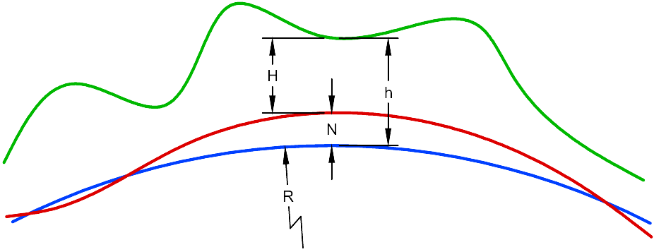
Standard Terminology
Standard NAD27 terminology for Scale Factors was changed for NAD83, in order to clarify usage.
NAD 27*
Scale Factor | Grid Dist / Ellipsoid Dist
Sea-Level Factor | R / (R + H)
Grid Factor | Scale Factor · Sea-Level Factor
NAD 83**
Grid Scale Factor | Grid Dist / Ellipsoid Dist
Elevation Factor | R / (R + H + N)
Combined Factor | Grid Scale Factor · Elevation Factor
* From Definitions of Surveying and Associated Terms, ACSM/ASCE, 1978
** From State Plane Coordinate System of 1983, James E. Stem, 1989
Ground Surface
H = Orthometric Elevation
N = Geoid Height
h = Ellipsoidal Height
R = Ellipsoid Radius
Geoid
Ellipsoid

Slide 28
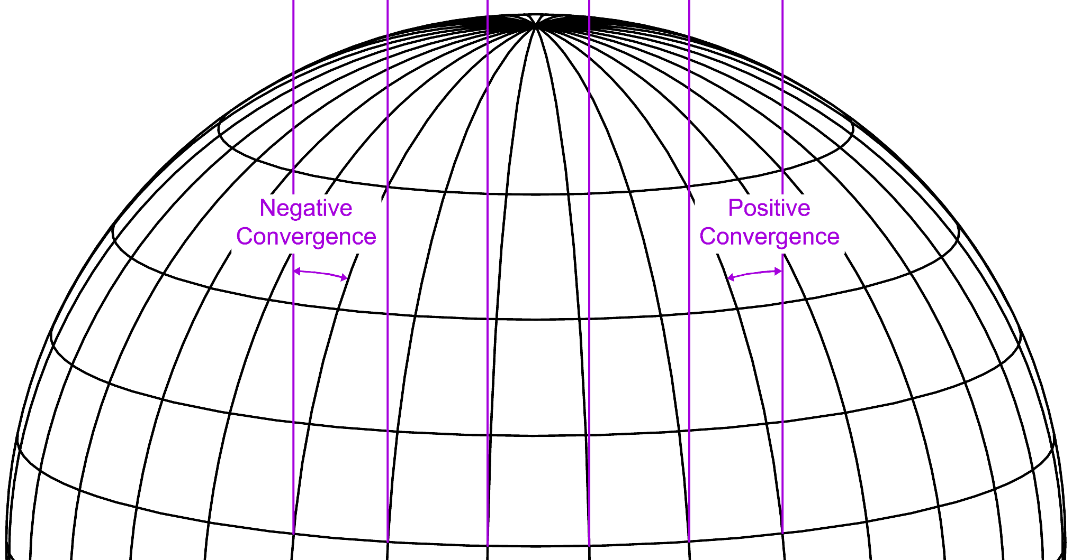
Convergence
Corrects for difference between Geodetic bearing and Grid bearing

Slide 29
Sample Excerpt from an NGS Data Sheet
The NGS Data Sheet
See file dsdata.txt for more information about the datasheet.
DATABASE = ,PROGRAM = datasheet, VERSION = 7.85
1 National Geodetic Survey, Retrieval Date = NOVEMBER 6, 2010
AE4270 ***********************************************************************
AE4270 DESIGNATION - ALEXANDER
AE4270 PID - AE4270
AE4270 STATE/COUNTY- CO/TELLER
AE4270 USGS QUAD - SIGNAL BUTTE (1994)
AE4270
AE4270 *CURRENT SURVEY CONTROL
AE4270 ___________________________________________________________________
AE4270* NAD 83(2007)- 39 05 14.50973(N) 105 12 25.63346(W) ADJUSTED
AE4270* NAVD 88 - 2518.5 (meters) 8263. (feet) GPS OBS
AE4270 ___________________________________________________________________
AE4270 EPOCH DATE - 2002.00
AE4270 X - -1,300,833.232 (meters) COMP
AE4270 Y - -4,785,511.112 (meters) COMP
AE4270 Z - 4,001,428.611 (meters) COMP
AE4270 LAPLACE CORR- -5.54 (seconds) DEFLEC09
AE4270 ELLIP HEIGHT- 2504.113 (meters) (02/10/07) ADJUSTED
AE4270 GEOID HEIGHT- -14.32 (meters) GEOID09
AE4270
AE4270 ------- Accuracy Estimates (at 95% Confidence Level in cm) --------
AE4270 Type PID Designation North East Ellip
AE4270 -------------------------------------------------------------------
AE4270 NETWORK AE4270 ALEXANDER 2.31 1.78 9.51
AE4270 -------------------------------------------------------------------
AE4270
AE4270; North East Units Scale Factor Converg.
AE4270;SPC CO C - 444,047.839 939,740.038 MT 0.99993594 +0 11 05.0
AE4270;SPC CO C - 1,456,846.95 3,083,130.44 sFT 0.99993594 +0 11 05.0
AE4270;UTM 13 - 4,326,491.926 482,087.149 MT 0.99960395 -0 07 50.1
AE4270
AE4270! - Elev Factor x Scale Factor = Combined Factor
AE4270!SPC CO C - 0.99960727 x 0.99993594 = 0.99954324
AE4270!UTM 13 - 0.99960727 x 0.99960395 = 0.99921138
AE4270

Slide 30
The “Grid to Ground” Problem
Using Grid and Elevation Scale Factors can correct for error, giving us accuracies that can be used for construction. So why not just use the grid system, such as State Plane or UTM?
Floating Scale Factors are not widely understood
Using Floating Scale Factors is complicated without specialized equipment (e.g. survey data collectors)
Plans labeled with both “Grid Distances” and “Ground Distances” are confusing to many people on the standard job site
Mixing up “Grid” and “Ground” distances can have serious repercussions

Slide 31
How big is the problem?
Grid Scale Factor at the center of a State Plane Zone may be ~0.9996
At an elevation of 8000 feet, the Elevation Scale Factor is also ~0.9996
The Combined Scale Factor for a project at this location would be approximately 0.9992 (linear distortion ~ 800 PPM)
This is only about 1” per 100’ – but that can:
Have serious repercussions for prefabricated structures
Wreak havoc with control and boundary surveys
Ground Distance AB = 100.08’
A
B
A’
B’
Grid Distance A’B’ = 100.00’

Slide 32
A Standard Approach: “Modified” State Plane
No such thing as “Modified State Plane”!
It’s really a “Project Coordinate System”, i.e. a ground-based coordinate system, which is tied to State Plane at a single Base Point.
Coordinates are converted between our Project System and State Plane by multiplying or dividing the coordinates by the Combined Scale Factor for the Base Point (and applying an optional horizontal translation/rotation).
Configured in Civil 3D by using the Transformation Tab

Slide 33
“Scaling the Grid”
We identify a Combined Scale Factor (CSF) for our Project, using the scale factors at our selected Base Point
Creates an approximate conversion between our Project Coordinates and Grid Coordinates
Error increases rapidly with distance from Base Point
Three standard methods
Localized Coordinates: Take the Grid Coordinates for the Base Point, then divide them by the CSF to determine the Localized Coordinate for our base point
Stretched Coordinates: Take Localized Coordinates, and then move them so that the coordinates of our Base Point remain unchanged
Project Coordinates: Take Localized Coordinates, and them move them to an arbitrary location that is not used by other systems, preventing confusion

Slide 34
“Scaling the Grid”
The Grid Surface (such as State Plane) is “scaled up” to ground using the Combined Scale Factor for a control point located near the center of the Project
Ground Surface
Base Point
(Scaled coordinates)
Average Project Elevation
“Scaled” Projection Surface
Ellipsoid
Grid Surface
Base Point
(Grid coordinates)

Slide 35
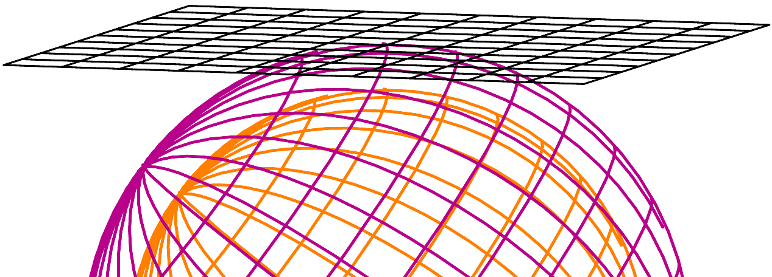
“Scaling the Grid”
Scaled Base Point is used as the basis for a Project Coordinate system
Project Coordinates are multiplied by the Combined Scale Factor to calculate an approximate Grid Coordinate
But we’re also back to Surveying on a plane…
Project Coordinate Grid
Base Point
(Scaled coordinates)
Average Project Elevation
Ellipsoid

Slide 36
Sample Scaled Coordinates
Grid | Localized | Stretched | Project
1,500,000.00 3,500,000.00 | 1,500,600.24 3,501,400.56 | 1,500,000.00 3,500,000.00 | 50,000.00 50,000.00
1,500,500.00 3,500,500.00 | 1,501,100.44 3,501,900.76 | 1,500,500.20 3,500,500.20 | 50,500.20 50,500.20
1,499,200.00 3,501,100.00 | 1,499,799.92 3,502,501.00 | 1,499,199.68 3,501,100.44 | 49,199.68 51,100.44
1,502,500.00 3,497,500.00 | 1,503,101.24 3,498,899.56 | 1,502,501.00 3,497,499.00 | 52,501.00 47,499.00
1,495,000.00 3,495,000.00 | 1,495,598.24 3,496,398.56 | 1,494,998.00 3,494,998.00 | 44,998.00 44,998.00
Using Combined Scale Factor = 0.9996

Slide 37
Problems with Project Systems
No unique way to define a Project System
Depending on how the system is setup, it may be easy to mix up coordinates (e.g. coordinates may be confused with State Plane Coordinates)
Does not reduce the linear distortion
Coordinate conversions have error that increases rapidly with distance from the Base Point
Transformation Tab is only available in Civil 3D, and settings are ignored by Map commands

Slide 38
Example of a Problem
Company A performed Survey A on a Project System scaled from the State Plane grid (e.g., a “Modified State Plane” system)
Company B performed Survey B using actual State Plane (survey performed “on the grid”)
Company C performed Survey C using a completely different Project System (also scaled from State Plane, but using a different base point than Survey A)
Company C combined all Surveys into one, not realizing they were using different coordinate systems, and then did their design
Power plant site grading was done 400’x600’ in the wrong place!
This is not a hypothetical example…
…It really happened!!!

Slide 39
An Alternate Approach: Low Distortion Projections
We define a new projection just for our site of interest, often called a “Low Distortion Projection” (LDP)
The LDP is defined in such a way that both grid and elevation scale factors are insignificant for our Project Area, and can be ignored for most purposes without introducing appreciable error
We define a new Coordinate Grid, using our LDP as the basis

Slide 40
Low Distortion Projections
Ground Surface
“Scaled” Projection Surface
Grid Surface
Ellipsoid

Slide 41
Low Distortion Projections
A Georeferenced Coordinate System is created on the LDP Projection Surface
LDP Projection Surface
Ground Surface
LDP Ellipsoid
Grid Surface
Ellipsoid

Slide 42
Defining a Georeferenced Coordinate System
The definition for a Georeferenced Coordinate System requires:
A Reference Datum
Projection Metadata
Linear Units

Slide 43
LDP Reference Datum
We may define a custom Datum, and may even use a custom Ellipsoid
Usually easier to simply scale a known Datum, such as NAD83
Therefore, most LDP definitions will reference a known Datum, and include a “Datum Scale Factor”

Slide 44
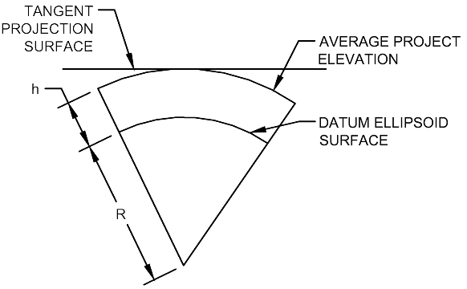
The Datum Scale Factor
Calculated from the average Ellipsoidal Height of our Project
Creates a projection surface that is tangent with our average Project elevation
h
R
k_{t} = 1 +
R = Ellipsoid Radius
h = Ellipsoidal Height
k_{t} = Scale Factor for
tangent projection
Ellipsoidal Height = Orthometric Elevation + Geoidal Height

Slide 45
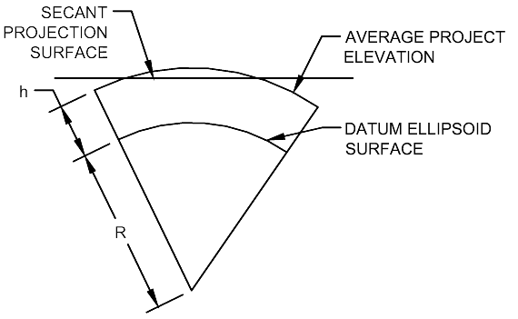
Dropping the Projection
We then multiply the Scale Factor by an additional factor k_{r}, lowering the Projection surface slightly, and increasing the extents of the usable zone
k_{s} = k_{t} · k_{r}
k_{t} = Scale Factor for
tangent projection
k_{r} = Additional scale
reduction factor
k_{s} = Scale Factor for
secant projection

Slide 46
Additional Scale Reduction
Scale Factor k_{r} | Distortion | Approximate separation of standard parallels (Lambert) | Zone Width
0.999999 | 1 ppm | 0° 10’ | 16 miles 26 km
0.999998 | 2 ppm | 0° 14’ | 22 miles 36 km
0.99999 | 10 ppm | 0° 31’ | 50 miles 80 km
0.9999 | 100 ppm | 1° 37’ | 158 miles 254 km

Slide 47
Refining the Scale Factor
To verify that our new local coordinate system is within acceptable error limits, we can check the Total Distortion
If Total Distortion exceeds acceptable limits, we can go back and adjust our Datum Scale Factor, then check Total Distortion again
R
R + h
δ = Distortion
k = Grid Scale Factor
R = Ellipsoidal Radius
h = Ellipsoidal Height
δ = k · ( ) - 1
(Multiply δ by 1,000,000 to get PPM)

Slide 48
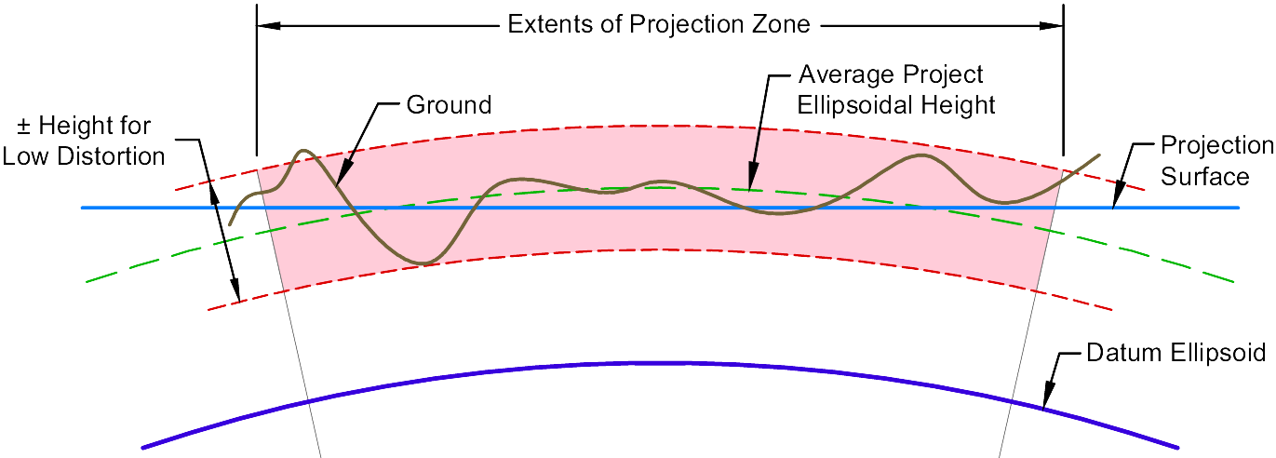
Low Distortion Projection Zone

Slide 49
Sample Distortion Analysis
Analysis produced in Civil 3D, using the Sincpac-C3D add-on
Available from Quux Software – http://www.quuxsoft.com

Slide 50
Rules-Of-Thumb
Using an existing datum (e.g. NAD83) as the basis is usually preferable to defining your own custom ellipsoid
Define the Datum Scale Factor to no more than SIX decimal places
Define Origins to an even degree or arc-minute
Use whole numbers for False Northings and Eastings
Define False Northings and Eastings in such a way that the coordinates cannot be confused with other standard coordinate systems for the area (e.g. State Plane or UTM)
Metadata for a Custom Projection must be published, or the data is useless for others

Slide 51
Sample Projection Metadata
All distances and bearings shown hereon are grid values based on the following projection definition:
Linear Unit: US Survey Foot
Geodetic Datum: NAD83
Vertical Datum: NAVD88
Projection: Lambert Conic Conformal, single parallel
Origin Latitude: N 39°00’
Central Meridian Longitude: W 105°03’
Scale Factor: 1.000410 (exact)
False Northing: 350,000
False Easting: 650,000
This projection was defined such that grid distances are equivalent to “ground” distances over the project area.
The Basis of Bearings is geodetic north. Note that grid bearings shown hereon (or implied by grid coordinates) do not equal geodetic bearings due to meridian convergence.

Slide 52
Caveats
Map transformation commands (i.e. Map Queries) do not work on Civil 3D entities.
LandXML Import/Export does NOT transform coordinates.
To transform Civil 3D entities they must be exploded or exported to plain Autocad format, then Map commands may be used to transform the “dumb linework”.

Slide 53
Example: Transforming a Civil 3D Surface
Extract TIN Triangles and Boundary from Surface
Create a new drawing and set it to your target coordinate system
Attach the new drawing to the drawing containing your TIN Triangles and Boundary
Query the TIN Triangles and Boundary into your new drawing
Create a new surface from the TIN Triangles and Boundary in your new drawing

Slide 54
Autodesk [and other] are registered trademarks or trademarks of Autodesk, Inc., and/or its subsidiaries and/or affiliates in the USA and/or other countries. All other brand names, product names, or trademarks belong to their respective holders. Autodesk reserves the right to alter product and services offerings, and specifications and pricing at any time without notice, and is not responsible for typographical or graphical errors that may appear in this document. © 2010 Autodesk, Inc. All rights reserved.

